Slide 1
Start – Eu - up
Erasmus+ KA2 Project Student Mobility
From 2019 to 2022

Slide 2
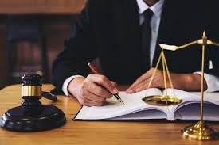
Lawyer

Slide 3
Who is a lawyer?
A lawyer is a person who provides legal assistance to physical and legal people. Also, he exercises and protects their rights and legal interests.

Slide 4
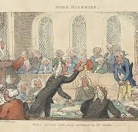
Short history of lawyers
Lawyers have their roots in Greece and Rome. The legal profession was modernized by King Edward I of England in the late 13th century. The legal profession was further modernized in the early days of United States in the 18th century.

Slide 5
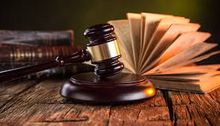
Wanted characteristics
Drawing valid conclusions about legally relevant facts
Having well-developed logical reasoning skills
Having flexibility in thinking
Having skills in applying theoretical knowledge to specific life situations
Having patience in dealing with others
The most important is to have skills of communication, ease of oral expression and being persuasive.

Slide 6
education
To become a lawyer, it is necessary to complete a Law Graduate University. In the Republic of Croatia, law can be studied at various universities. After completing the law studies, you receive the academic title of Masters Degree. Further education can be continued at postgraduate studies.

Slide 7
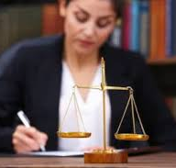
Job
A lawyer represents physical or legal person in various types of court proceedings by presenting evidence that speaks in favour of their parties. He also acts as a consultant, informing his clients of their rights and obligations and proposing appropriate action in business and in personal situations. The lawyer also compiles legal documents, such as wills or other types of contracts - sales, gift, lease, exchange, construction, inheritance, founding companies, etc. The lawyer can lead general meetings of joint stock companies, registrations and all kinds of lawsuits. The lawyer prepares internal acts for companies, advises on construction and renovation, and cooperates in public procurement procedures.

Slide 8
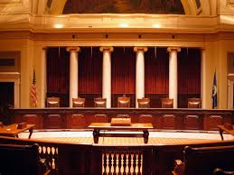
Work culture
A lawyer works in a closed, regulated work environment, such as a law office, court, business premises of parties, municipalities, state attorney's offices, etc. He performs his work mainly in a sitting position, and often uses a computer for his work. He usually has his own office, and can also work in partnership with colleagues in the law firm. He organises working hours on his own. Many lawyers represent their clients in court in the morning while receiving new clients in the office in the afternoon or preparing defences and lawsuits for individual cases. Sometimes, if they represent people who are in prison or penitentiary, they visit their clients in the mentioned facilities.

Slide 9
Hiring
Lawyers can be employed in the judiciary, in individual institutions and in state authorities. In order to work in law area, you need to pass the Bar exam. Opportunities for advancement in the hierarchy of the judiciary directly depend on your work experience.

Slide 10
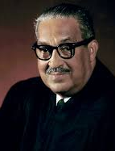
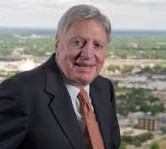
Famous Lawyers
Joe Jamail
Thurgood Marshall
John Adams
Abraham Lincoln

Slide 11
Thank you!
8.A razred

