Slide 1
Start – Eu - up
Erasmus+ KA2
(2019. – 2021.)

Slide 2
VIRTUAL MARKETPLACE
or
HOW TO BE ENTERPRISING AND THE AGE OF LOCKDOWN:
PROFESSION AGRICULTURIST

Slide 3
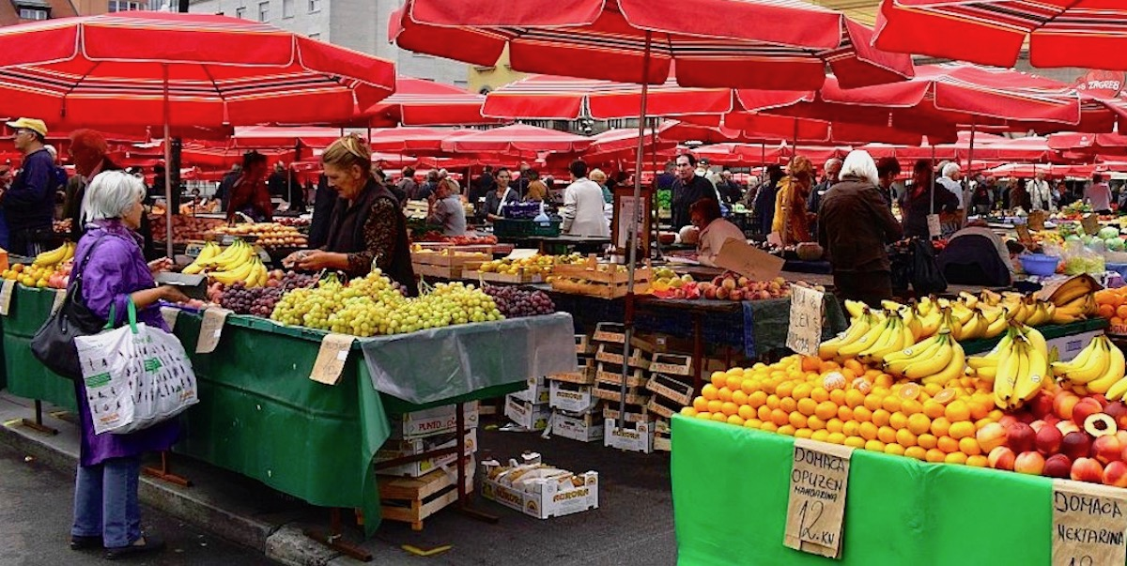
From ancient times, Croatian citizens are known as lovers of healthy and organically grown food. Such food is produced mostly in rural areas around cities and larger settlements on small family farms. Such naturally grown food is mostly sold by small farmers at city markets.

Slide 4
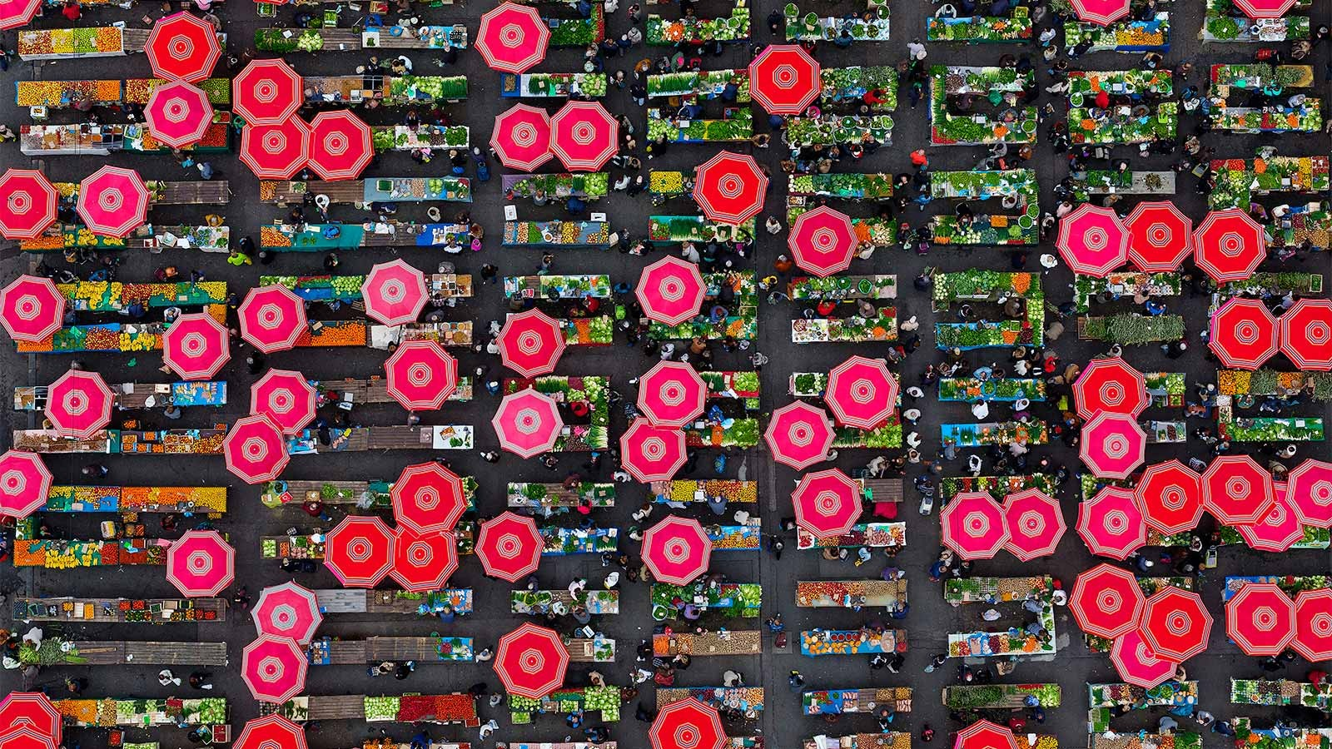
Zagreb, Dolac – marketplace

Slide 5
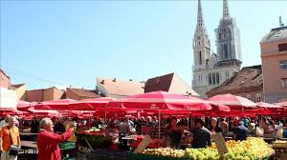
With its appearance and rich offer of food and flowers, the markets are a favorite place for many citizens to shop, and they are part of the tradition

Slide 6
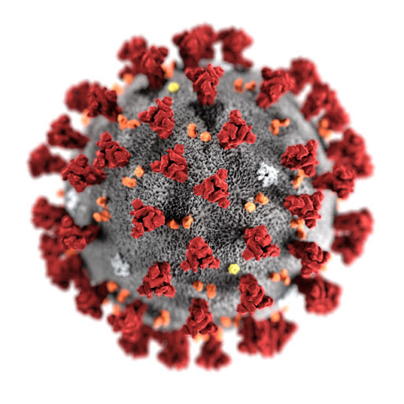
With the arrival of the epidemic of the COVID-19 virus, the sale of these healthy foods is stopped, the markets are closed due to the safety of infection, and the small farmers suffer the most damage.

Slide 7
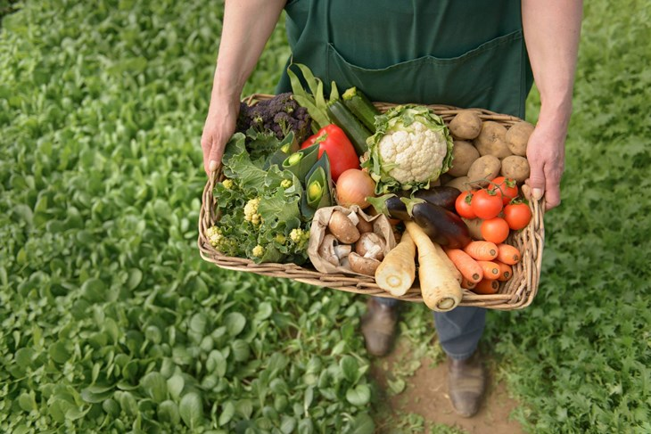
Buying local supports small Croatian businesses who really need it right now and it also reduces the pollution and environmental impact associated with importing food.

Slide 8
In response to the closure of markets due to the coronavirus pandemic, a number of Croatian cities have launched online markets. The City of Zagreb also joined them.

Slide 9
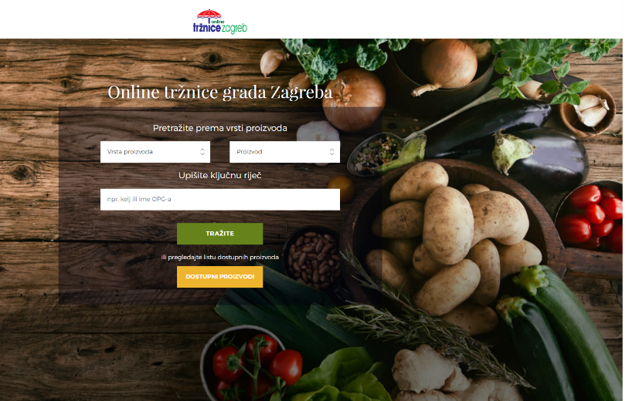
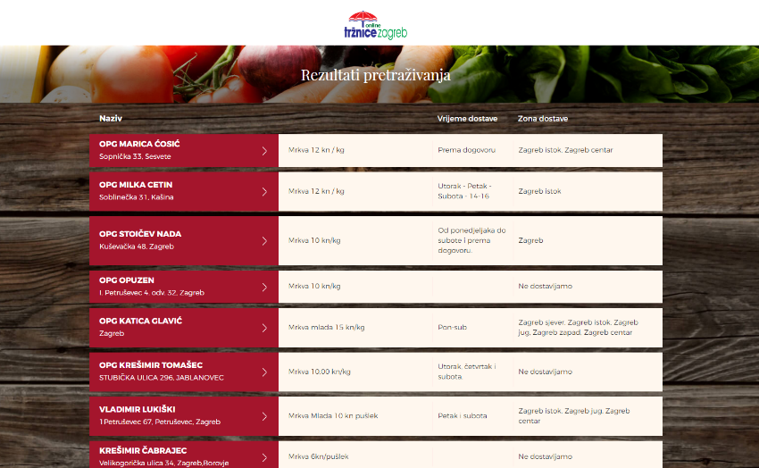
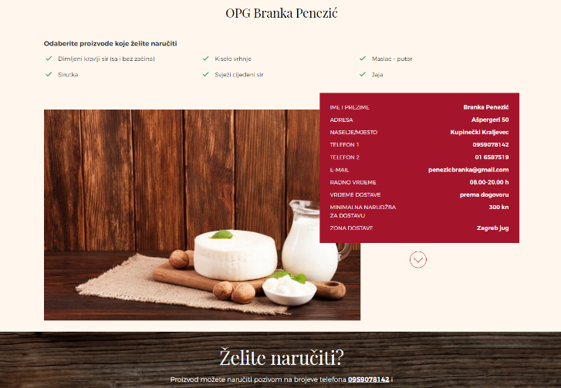
The Online Marketplace service is simple, functional and free. After entering the basic data, the owner of the family farm chooses the type of item he offers, enters the price, time and area of delivery as well as a short description of his products.
The goal of the platform is to connect producers and customers and thus promote local producers who are in a difficult position after the markets close.

Slide 10
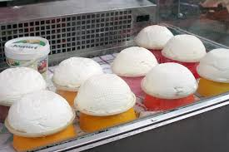
With the help of a virtual market, you can order fruits and vegetables and their products, eggs, cured meat products, dairy products, meat and meat products, pasta, bread and pastries, honey and beekeeping products and everything else that is normally sold in food products.

Slide 11
In the same time food delivery has become a lot more prevalent and commonplace in Croatia.

Slide 12
For the operation of the online market it is necessary to organize packaging and fast transport. It is possible that the manufacturer will be able to handle these tasks himself, while for the placement of goods through social networks and virtual marketplace applications, he will need an expert to create his own website and an expert in digital marketing.

Slide 13
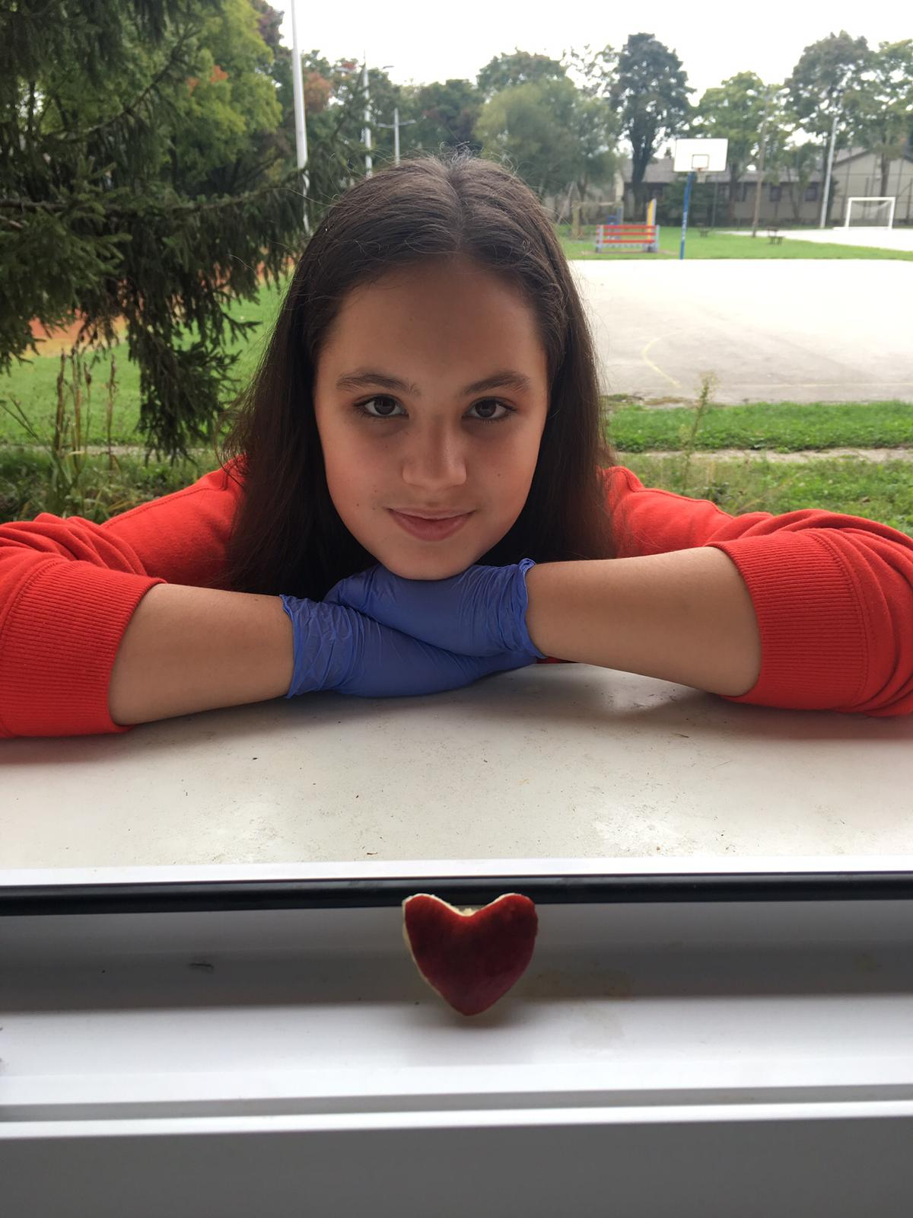
Students Erasmus team,
Primary school Grigor Vitez,
Zagreb, Croatia,
KA2 Start-Eu-Up
Coordinator:
Maja Vunderl Pasarić

